Slide 1
Chapter Ten

Slide 2
If I have a billion dollars, I will…

Slide 3
As an IT worker, I ….

Slide 4
Describe Chengdu based on your understanding

Slide 5
What will China look like after 100 years?

Slide 6
I want to work in Tianfu software park?

Slide 7
Luisa, thanks for your email about the new brochure and the attached file with the quote from the printers. It is very expensive. Isn’t it a better idea to contact some other printing firms and get some alternative quotes? After all, we have been very unhappy with the quality of their work on the last few jobs. What do you think?
It seems / I think it’s quite / a bit / a little / rather expensive.
Wouldn’t it be a better idea…
We haven’t been very happy…

Slide 8
Frank, sorry we didn’t have a chance to talk yesterday. Actually, I have a favour to ask. I wonder if you can have a word with Sandra in Human Resources about when the position of Sales Director is going to be advertised. It’s delicate for me, as I’m sure you understand, because there is a chance I will be one of the candidates. Thanks.
Actually, I have small favour to ask.
I was wondering if you could …
It’s a bit delicate for me.
I might / may be one of the candidates.

Slide 9
Steven, thanks for sending the suggestions on how to price our new range of accessories. I don’t agree with you. The prices you suggest are too high for the market. Don’t you think a lower price will result in higher sales and therefore higher profits? Let me know what you think.
To be honest, I’m not sure I agree with you.
The prices you suggest seem to be / might be quite / a bit / a little / too high for the market.
Don’t you think a lower price would result in ….

Slide 10
IT Vocabulary
Validation 确认 verification 验证
Analysis分析 analyze分析
inspection审核 requirement需求
Document文档 design设计
Diagram图表 program程序
Source code源代码 implementation实施
Test case 测试用例 custom software 定制软件
Generic software通用软件 incorporate整合
Release发布 phase 阶段
Deliver交货 specification规约
Fault 错误 defect 缺陷
Crash崩溃 interaction 交互

Slide 11
Corruption 损坏 perform运行
Statement 说明 result结果
Generate生成 policy策略
Execute执行，运行 feature性能
Function功能 access访问
Figure数字 expect预期
Process过程 require要求
Menu菜单 user 用户

Slide 12
Within the Validation and Verification process, there are two complementary approaches to system checking and analysis.
Software inspections or peer reviews analyze and check system representations such as requirements document, design diagrams and program source code. You can use inspections at all stages of a testing process. Inspections may be supplemented by some automatic analysis of the source text of a system or associated documents. Software inspections and automated analysis are static V &V techniques, so you do not need to run the software on a computer.
Software testing involves running an implementation of the software with testing data. You examine the outputs of the software and its operational behavior to check if it is performing as required. Testing is a dynamic technique of verification and validation.

Slide 13
The software testing process has two distinct goals:
To demonstrate to the developer and the customer that the software meets its requirements. For custom software, there should be at least one test for every requirement in the user and system requirements documents. For generic software products, there should be tests for all of the system features. Such features will be incorporated in the product release. Some systems may have an explicit acceptance testing phase. In this phase, the customer formally checks the delivered system against its specification.
To discover faults or defects in the software. Defect testing is concerned with rooting out all kinds of undesirable system behaviors, such as system crashes, unwanted interactions with other systems, incorrect computations and data corruption.

Slide 14

Meeting

Slide 15
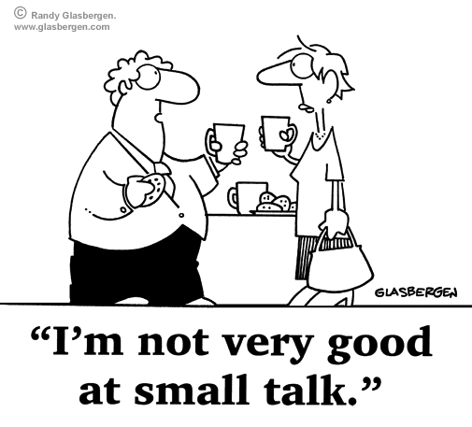


Types of meeting
Brainstorming
Chat
Project meeting / team meeting

Slide 16


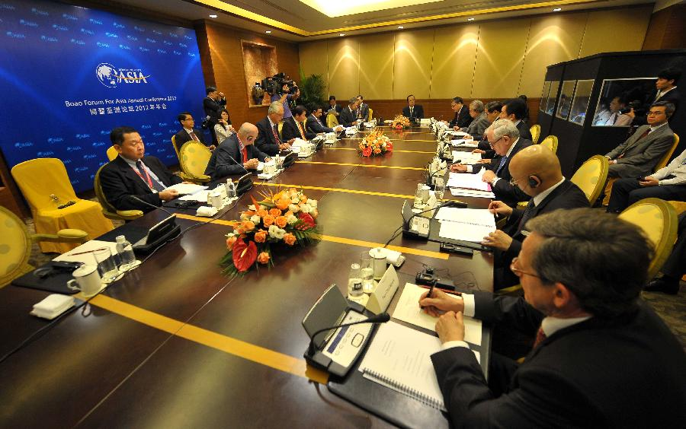
Department meeting
Meeting with a customer
Board meeting

Slide 17
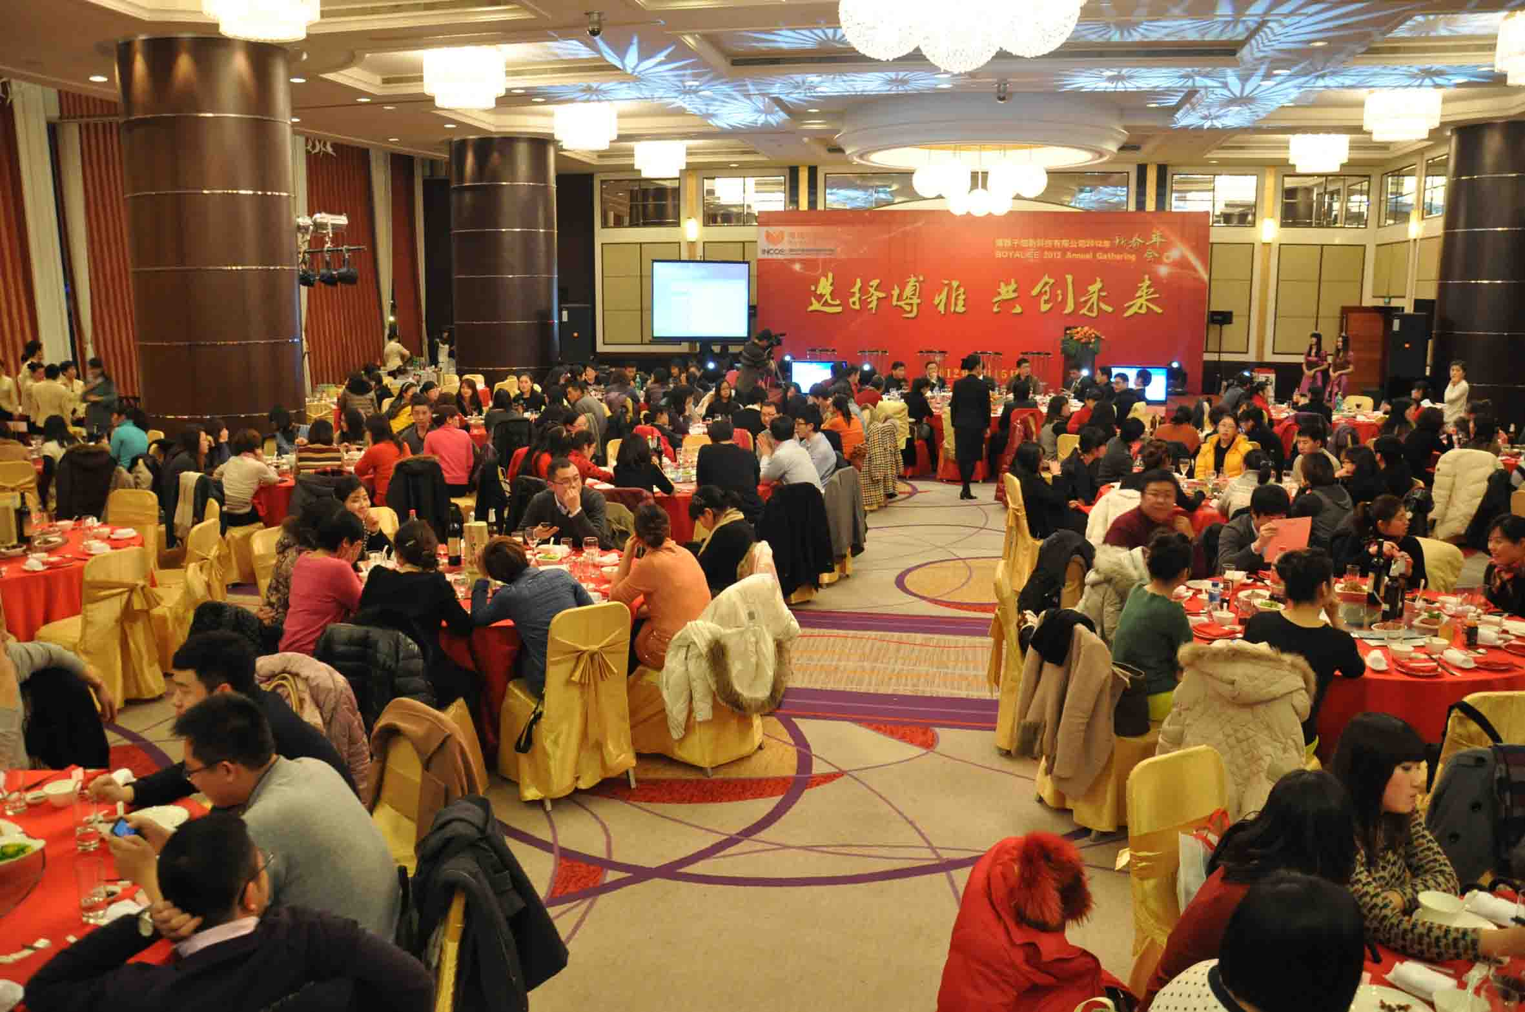
Annual meeting

Slide 18
Words combinations with “Meeting”
organize a meeting:
Make a meeting earlier than originally decided
change a meeting to a later time:
not have a planned meeting:
be in charge of a meeting:
go to a meeting:
not go to a meeting :
a list of items:
different things:
written notes of what is said:
arrange, set up, fix, schedule
bring forward
put back, postpone, delay
cancel
run, chair, host
attend
miss, make
agenda
items
minutes

Slide 19
Preparing a meeting
Holding a meeting

Slide 20

Preparing a meeting
Question:
What will you prepare when you are going to have a meeting?
Time
Place
Purpose
Other preparation
(computer, projector, flip chart, remote, refreshment)

Slide 21
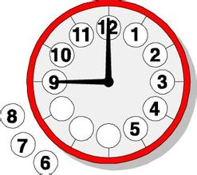
Time
Can I suggest we have a teleconference with our customer?
When will we meet?
When are we having the meeting?
When are we scheduled to meet?
When are we going to meet?

Slide 22

Place
Where will it take place?
What about the location / venue?
Where should we hold a meeting?
Do you think where the right place is?

Slide 23

Purpose
What is this meeting about?
What is the purpose of the meeting?
What are the objectives of the meeting?
May I know the agenda of the meeting?

Slide 24




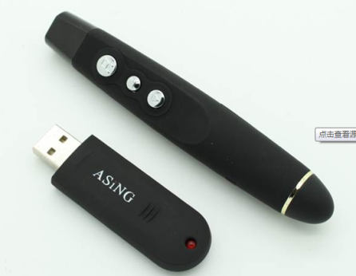
Additional preparations
Who will attend the meeting ?
Who will be the chairman?
Who will take the minutes?
Who will send out the meeting notice?
Do you need to reserve anything for the meeting?
Do you want to order any refreshments from catering?
Will any of the meals be provided?

Slide 25



Practice Manager------ Assistant
Can you prepare a meeting…?
Assistant ------ Receptionist
I need to reserve…
Assistant -----------Norwegian colleague
We’d like to …

Slide 26

Chairing a meeting

Slide 27
Introductions
1. Opening the meeting
2. Welcoming and introducing participants
3. Giving apologies for someone who is absent
4. Stating the principal objectives of a meeting
5. Introducing meeting procedures

Slide 28
Opening the meeting
If we are all here, let’s get started/start the meeting/start.
Let’s call the meeting to order.
Let’s get things started.
Let’s get things under way.
Good morning / afternoon, everyone.
Thanks for your coming.
We are glad that you have all come to attend our meeting.

Slide 29
Welcoming and introducing participants
Please join me in welcoming…
We’re pleased to welcome…
I’d like to extend a warm welcome to …
It’s a pleasure to welcome…
I’d like to introduce…
Please help me in giving a warm welcome to…
Let’s put our hands together in welcoming no other than …

Slide 30
Giving apologies for someone who is absent
I’m afraid…, (name) can’t be with us today. She is in…
Unfortunately, (name)… will not be with us today because he…
I have received apologies for absence from (name), who is in (place)

Slide 31
Stating the principal objectives
We’re here today to…
Our main aim today is to…
I’ve called this meeting in order to…

Slide 32
Practice
欢迎天府软件园培训部部长战薇出席此次会议
Lucy因出差不能来参加此次会议
会议目的是讨论NCS英语培训项目
会议流程：培训内容
培训时间
培训费用

Slide 33
III. Topic: Refusal
1. Structure

Slide 34
euphemistic
reasonable
persuasive
alternative
给出建议的解决方案
honest humble

Slide 35
2. Tone and Diction
Refusal: Euphemistic
Reason: persuasive
reasonable

Slide 36
3. Useful expressions
I regret to say …
Unfortunately, I’ll …
We are pitiful to tell you that …
However, we are unable…
I am afraid…
We are really sorry that…
We are regretful that…

Slide 37
I regret to say that we cannot agree to your request for an appointment.
本公司暂未能安排会面，深感歉意
I regret to say that we cannot agree to your request for technical information regarding our software security systems.
来信要求本公司提供有关软件保密系统的技术资料，本公司亦不便透露，尚请见谅。
Unfortunately, I’ll be abroad on that day and I won’t be able to make it.
不幸的是，那天我出国，将不能参加了。
We are pitiful to tell you that the products are not well calculated for our market.
我们不得不遗憾地通知贵公司，你们的产品不适合本地市场。
However, we are unable to fulfill the order because all our products have been out of stock.
但是我们现在无法完成订单，因为所有产品已售罄。

Slide 38
非常不好意思，这次我们要谢绝你的报价。
I am afraid we must decline your offer this time.
很抱歉，我们无法接受你所建议的价格，因为这个价格是我们认为目前最合理的价格。
I am really sorry that we can not offer the price that you suggested as it is the most favorable price we can offer you at present.
感谢你的合作，并为此产生的不便向你道歉。
Thanks for your cooperation and we are regretful about the inconveniences that may bring to your business.
我很抱歉通知你，我们公司不接受延迟交货。
I’m sorry to inform you that the late delivery of goods is unaccepted by our company.

Slide 39
敬请谅解。
Thank you for your understanding.
取消约会，敬请谅解。
Please don’t feel annoyed at our rejection of your offer.
如需本公司协助其他事宜，欢迎随时赐顾垂询。
If there is any other way in which we can help, do not hesitate to contact us again.
希望下次有其他的合作机会。
We are seeking another cooperation with you next time.
很抱歉未能给你提供任何帮助。
I’m sorry that I can’t be of any assistance to you about that.

Slide 40
Example 1:
rejected bkg

Slide 41
Example 2:
Dear Sir or Madam,
I’m sorry to inform you that the late delivery of goods in your letter on 7th of Nov. is unaccepted by our company. Your delay will put us in an embarrassing position, for which we have to make many explanations to our customers. And the confidence of our company will be greatly affected.
We must reiterate the delivery on time to be regarded as an essential condition for us.
Yours sincerely,
Lily

Slide 42
In-class exercise:
收件人：RF team
内容：RF team打算把一个未经分析，无法证明是我们BTSOM问题的bug转给我们，果断拒绝! (对方觉得是我们的问题，但是没有有说服力的证据）

Slide 43
Dear RF team members,
I’m sorry to inform you that the pronto transfered to us has to be unaccepted by us.
You hadn’t paid any analysis on it before you transferred it. And you can’t confirm it’s a problem with OAM. If you want to transfer to us, please provide your evidence or other reason that can convince us.
We must reiterate we are unable to accept this transferring of this pronto. Thanks for your understanding.
Yours sincerely,
Peter
tough

Slide 44
Hello RF Team,
I am from TA team. I was very concerned when receiving your request about Bug100. But we are pitiful to tell you that we can’t accept you transfer the bug to us. It is not persuasive reason, according to your statements. we can’t get detailed and analyzed log about this bug from you. If it is urgent to you, you can contact Linna. She is the specialist in analyzing bug and can help you locate the resource of problem.
We are sorry we can’t be of any assistance to you.
Your sincerely,
Skya Wang
soft

Slide 45
Dear RF Team,
I am from OAM team, and thanks for your letter.
After carefully reviewing all the logs you sent, I am regretful that we decided to accept your request. Please wait and hold on, this bug cannot transfer to us.
Because there is lack of analysis from your team, more important is that, there is no evidence to prove this issue related to OAM.
I am afraid you should do further investigation, however we can give some support from our team if necessary. Thank you for your understanding.
Best regards,
Tom

Slide 46
Hi RF Team,
We are regretful that we would decline this pronto as you can’t prove the issue is on OM side. Could you please analyze this issue further more, and point out the reason that this issue is on OM side but not RF side? Any problems, please don’t hesitate to contact us.
We are so sorry for this.
Best Regards,
Linna

Slide 47
收件人：同事
内容：同事来邮件希望能帮忙写一份报告，但因工作很满，抽不出时间，写封拒绝信
Hello Lino,
I’m sorry I can’t write the report for you as I’m fully tied up with my work these days. If it’s not urgent, I can help you next week. Or you can ask X team if they can give u a hand.
Best,
David

